Slide 1
Modular Wireless Xbox Kinect Data Transfer Device (MWXKDTD)
Team: ECE 409
Millad Nooristani, Eric Olson, Ayush Rohatgi

Slide 2
Project Description
This project to allow several Xbox Kinects to connect and transmit to a host system simultaneously
This is useful for two reasons:
It gives wireless functionality to the Xbox Kinect with Windows 10
It allows several Kinects to work on the same system, which is not doable through USB hardwire connection
This will most likely be used for research purposes
This is the main use of all Xbox Kinects currently
This allows multi-Kinect systems to be more spread out and to function on the same system without the installation of extra PCI cards

Slide 3
Requirements
Main Requirements:
Host a steady stream of Kinect data to be displayed on a host system
Allow for multiple streams simultaneously
Integrate with existing Kinect projects
Sub-Requirements:
The addition of multiple streams does not impact the quality of existing streams
Able to switch between data type streams at user command
User-friendly Windows interface

Slide 4
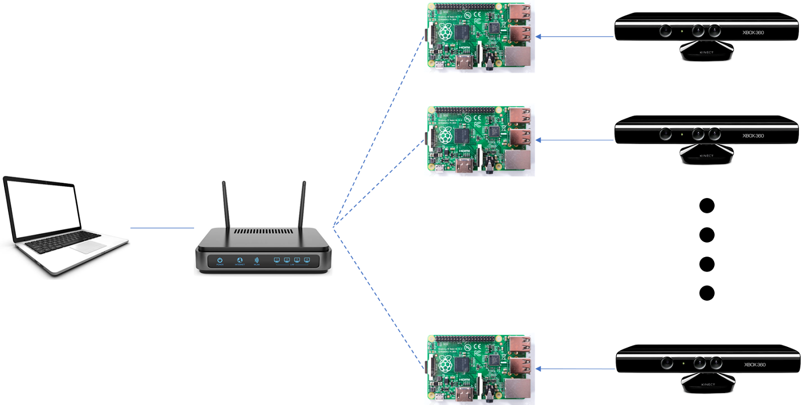
System Overview: Conceptual Functional diagram

Slide 5
System Overview: Major Functions/Subsystems
Major Functions
Kinect data capturing
Performed on Raspberry Pi
Uses installed libraries Libfreenect and OpenCV
Sends data using SSH Wi-Fi connection protocol over a closed network
Host System Display
Still in development
Will most likely be through Matlab or created GUI

Slide 6
Design and Justification: Conception
Self created idea
Only constraint was to use a Raspberry Pi and a Kinect
Earlier ideas
Wired Kinect Hub for multiple Kinects on one PCI card
Too many Pis to make economic sense
Bluetooth Xbox Kinect Data Transfer Device
Bluetooth proved slow and annoying to use

Slide 7
Design and Justification: Current
Modular Wireless Xbox Kinect Data Transfer Device
The switch to using a Wi-Fi network accomplished many things:
Cheaper than original wired hub (one less Pi required)
Limited data loss as compared to Bluetooth
Even more relevant when supporting multiple cameras
Larger range
Easier to extend Wi-Fi network range than to extend Bluetooth network range

Slide 8
Implementation of Design: Functions
HW
Pi and Host Computer
Wireless communication through SSH Wi-Fi protocol
Xbox Kinect
RGB and Depth Image capture
SW
Pi
Python scripting
Data capturing, parsing, and forwarding to host system
Host (Windows System)
Data receiving
User Friendly data display and data type options
User ability to activate/deactivate individual cameras on the network

Slide 9
Implementation of Design: I/0
Inputs
Kinect -> Raspberry Pi -> Host
RGB and Depth Image data
Host -> Raspberry Pi
User inputs: data types, activate/deactivate
Outputs
Host
RGB or Depth Image data

Slide 10
Implementation of Design: Integration
SW
Kinect is a Windows product, and Pi is running Raspbian
This is solved with the libraries Libfreenect and OpenCV
Image data from the network to the host
This is still in development
I/O
Kinect <-> Pi
USB 2.0
Pi <-> Network
Wi-Fi
Network <-> Host
Ethernet

Slide 11
Work Breakdown
Main Tasks
Stream and display data from Pi to Host (in progress)
Add multiple simultaneous streams from several Pis
Do something with the stream (most likely legacy multi-Kinect facial recognition project)
Who is doing what
Now: Stream and Pi-case
Whole group
Later: Multiple Streams and facial recognition
Will split into teams

Slide 12
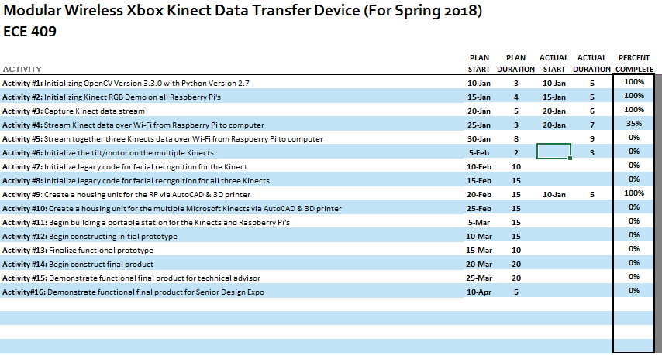

Slide 13
Moving Forward
Currently
We have isolated the data from the Kinect on the Raspberry Pi
We need to find the most efficient way to transmit the data
Slowest: We convert the data to image format on Pi and send
Tested: 4-5 FPS with transmission
Fastest: We don’t modify data at all on Raspberry Pi
Tested: 30 FPS without transmission
Problem: we need to find a way to process data on host system

Slide 14
Moving Forward
Future
Find way to process data on Host and display
Possible ways
Write a GUI from scratch and process data for display in real time
Try to virtualize Kinect data for use with existing Matlab library

